Slide 1















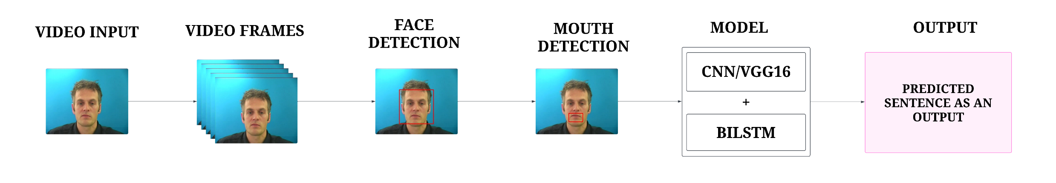
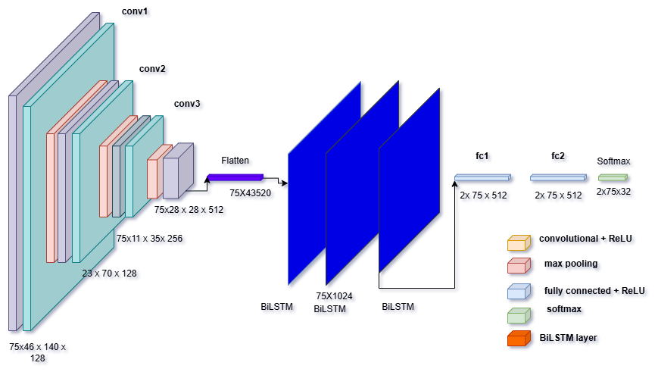
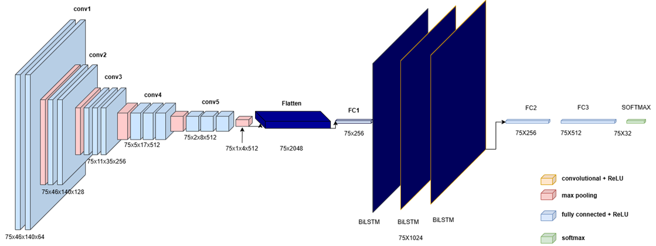
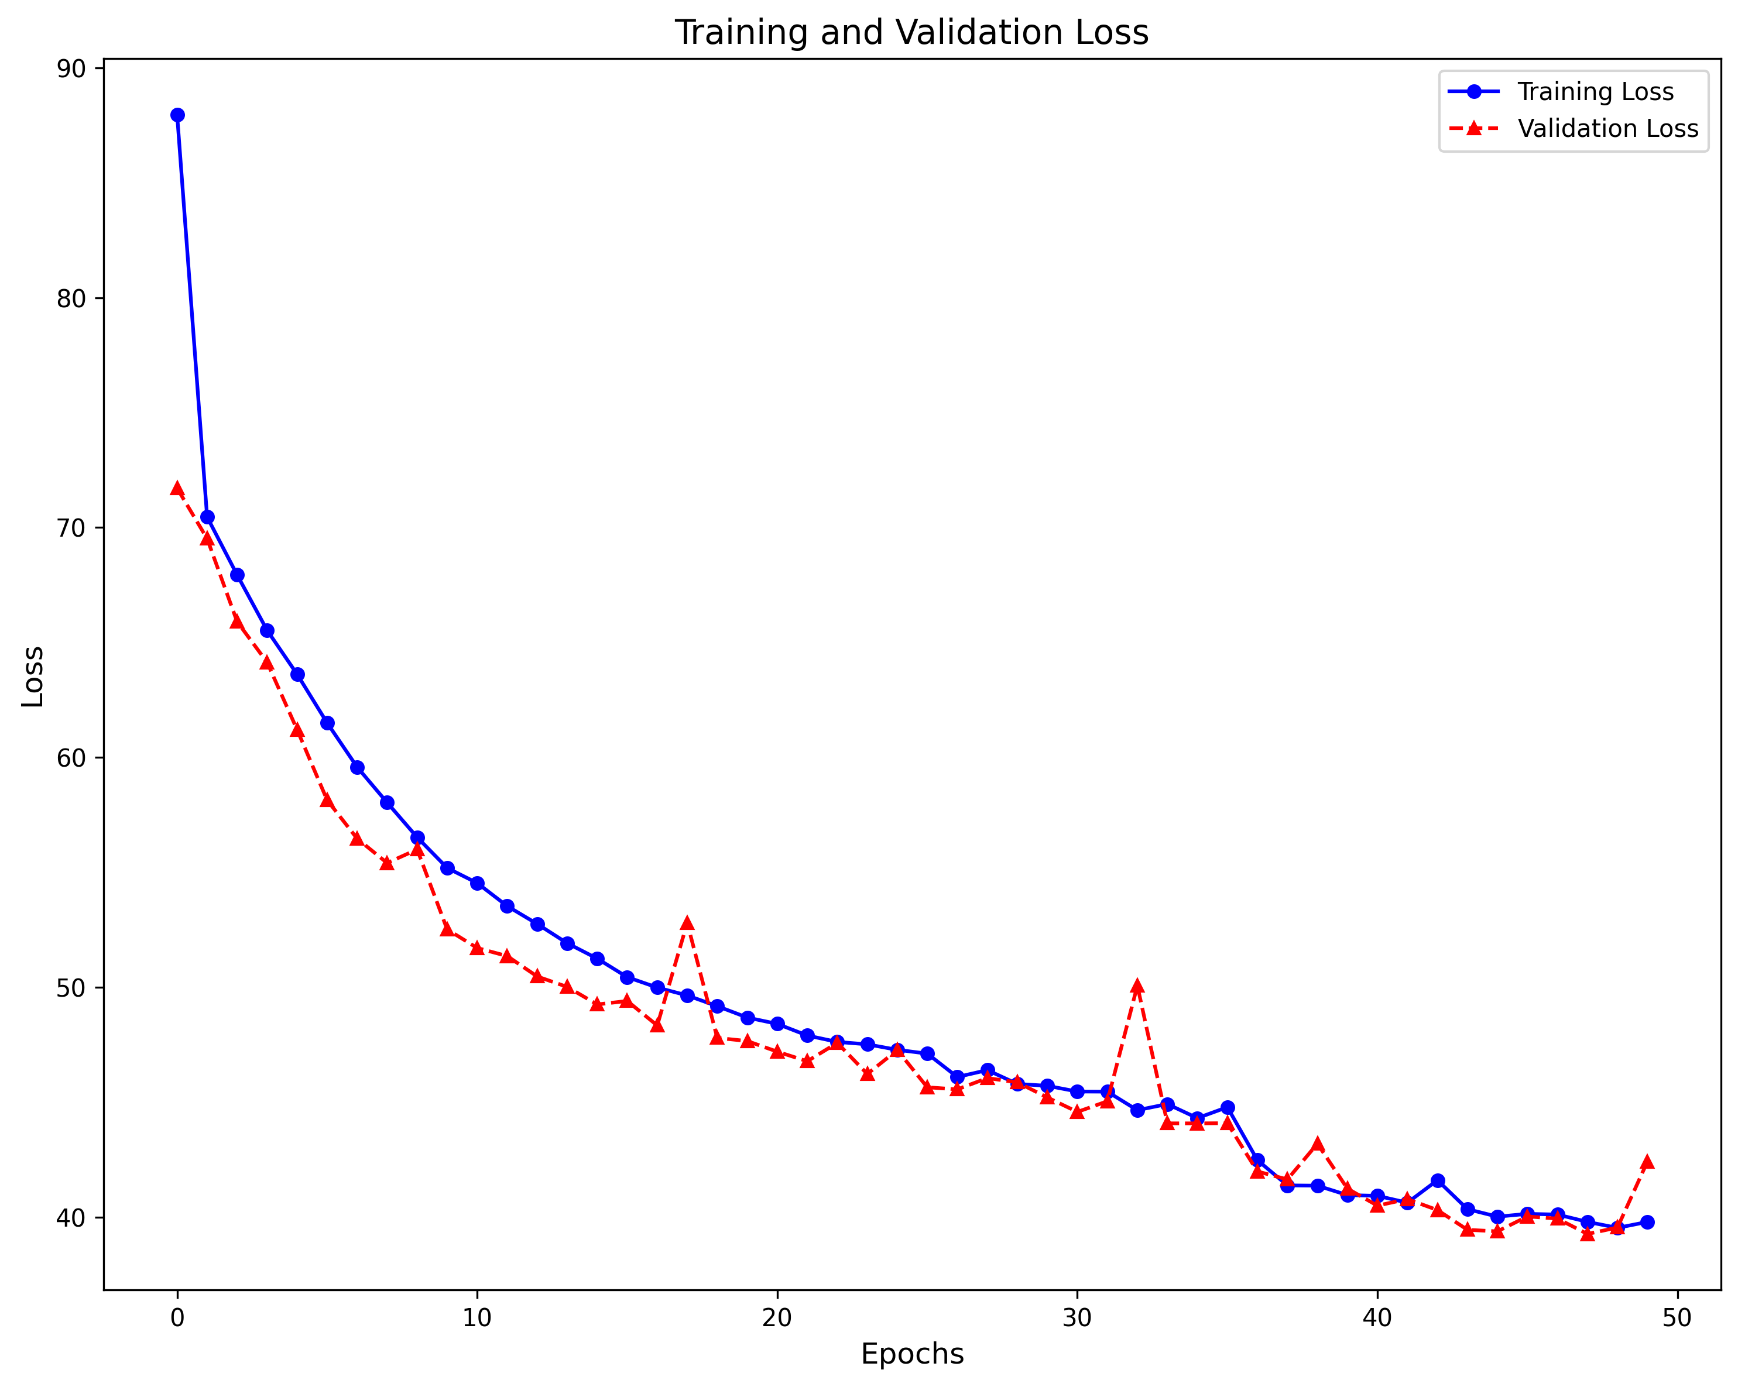
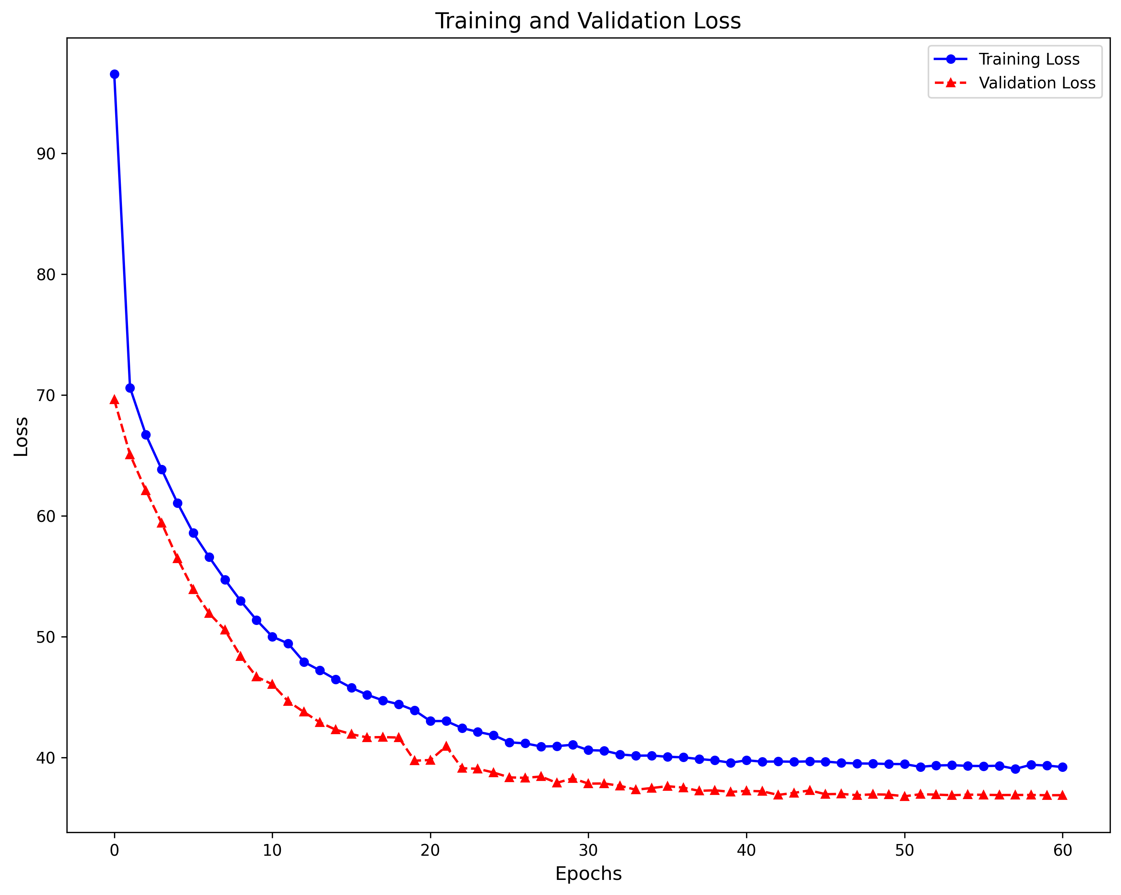
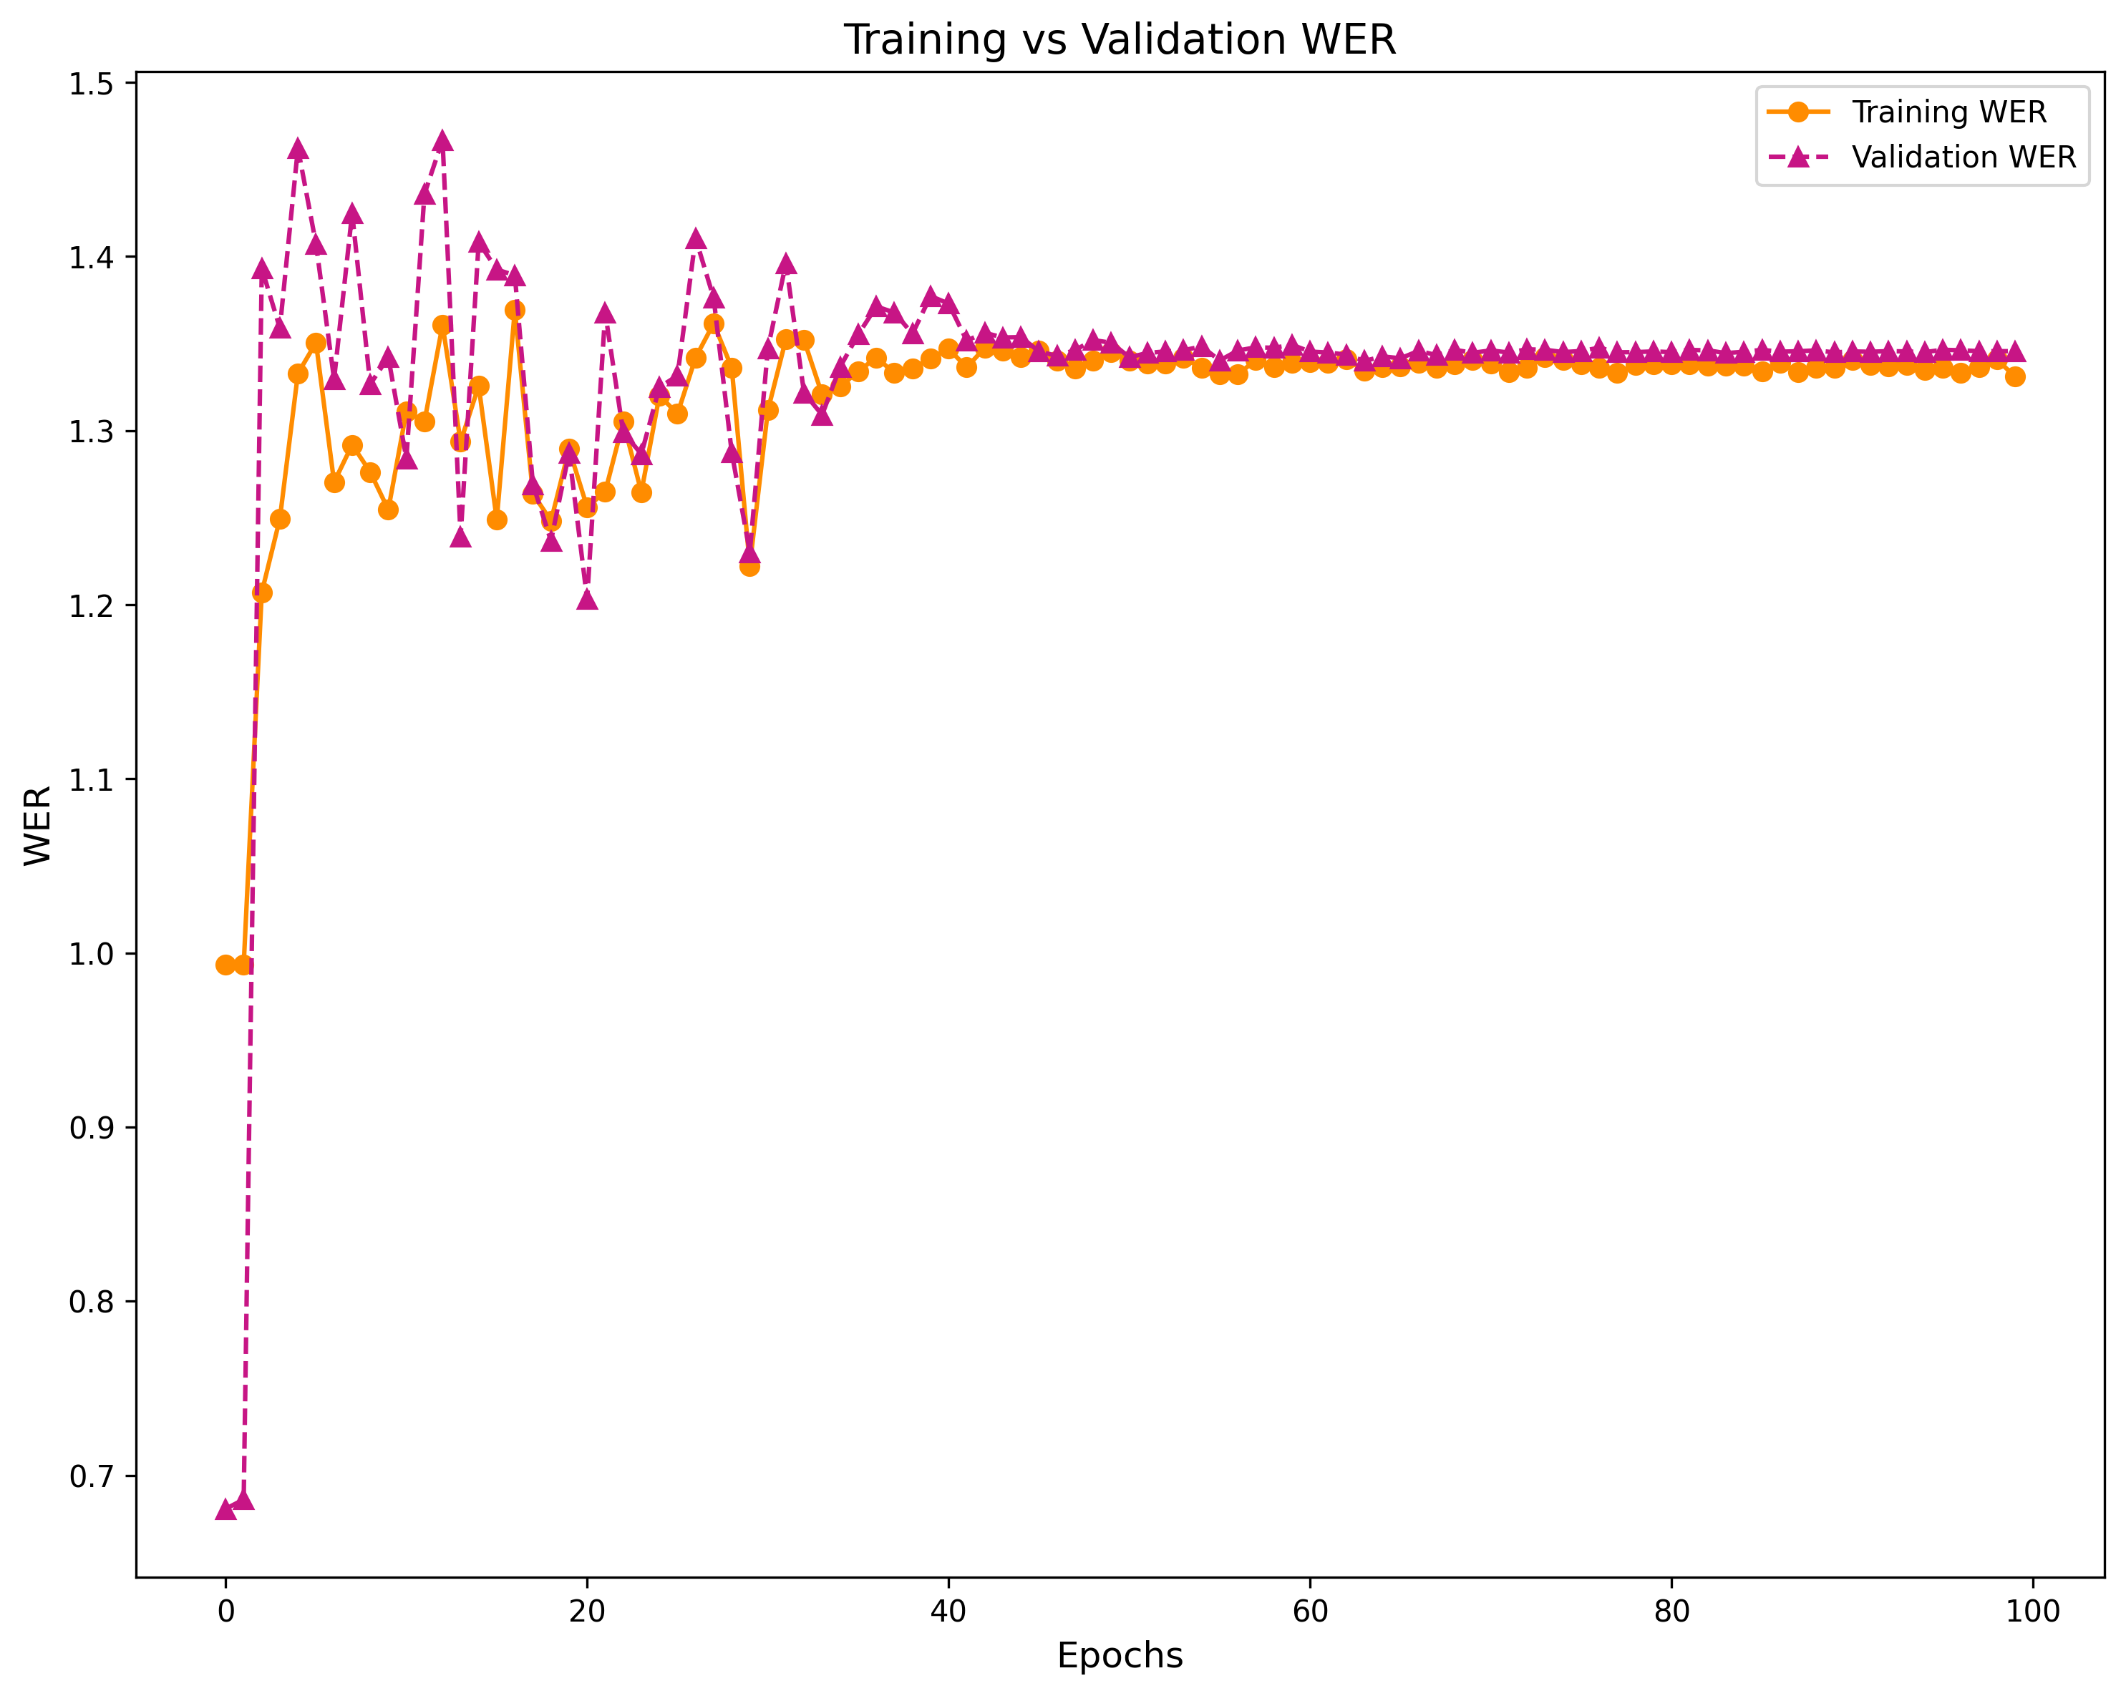
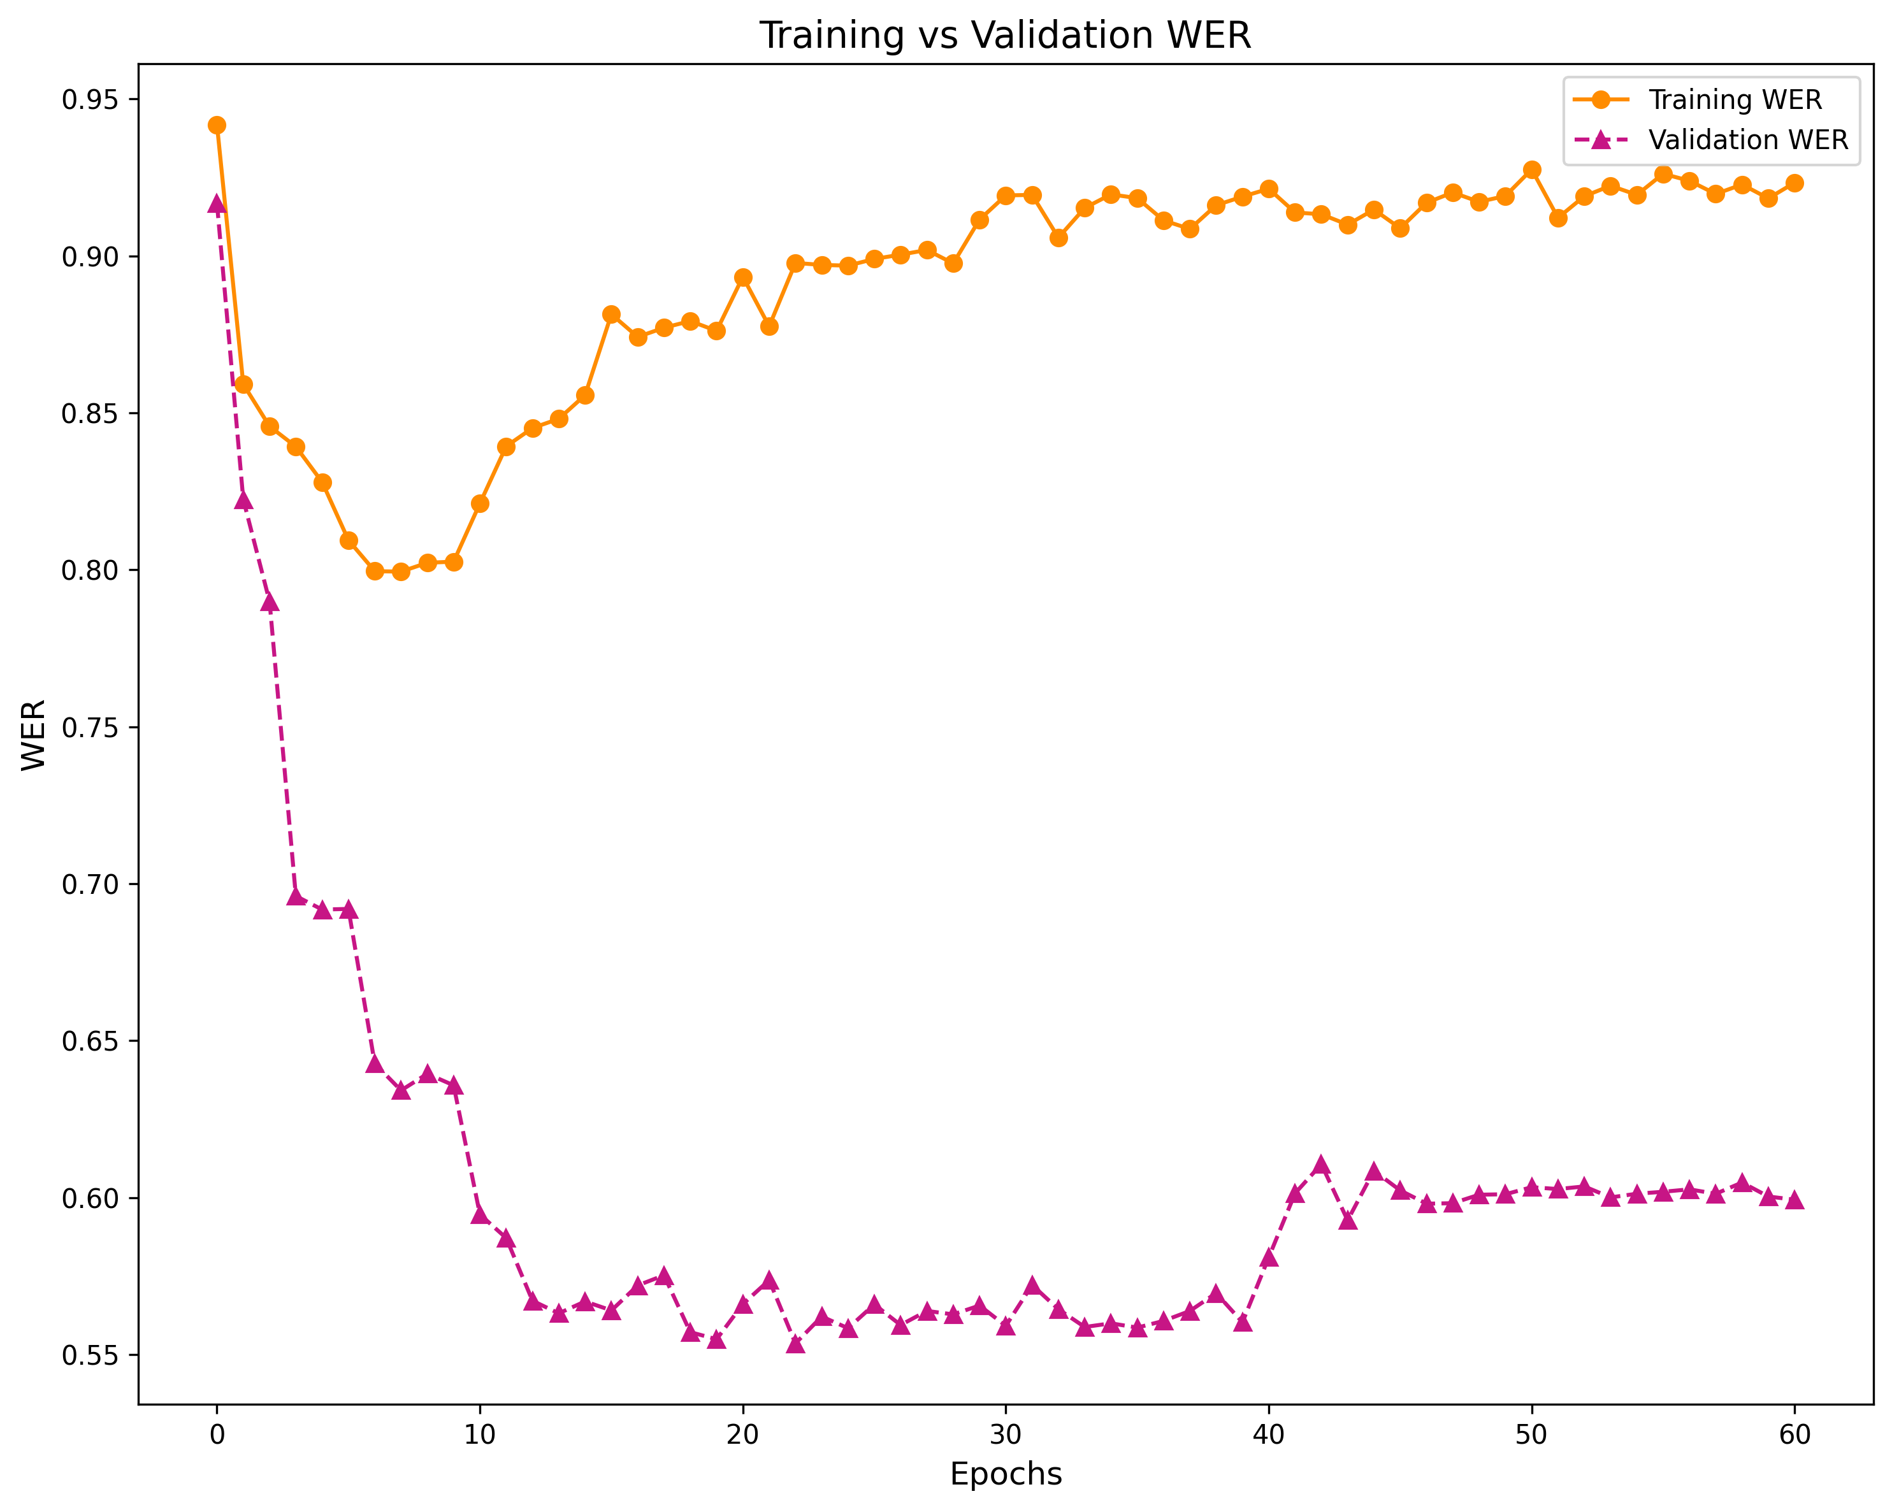
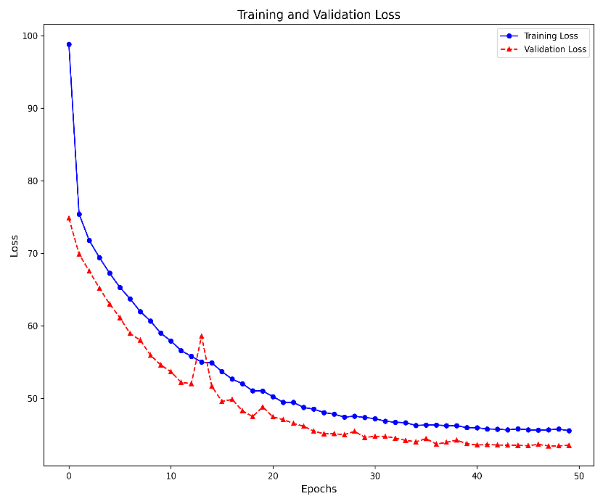
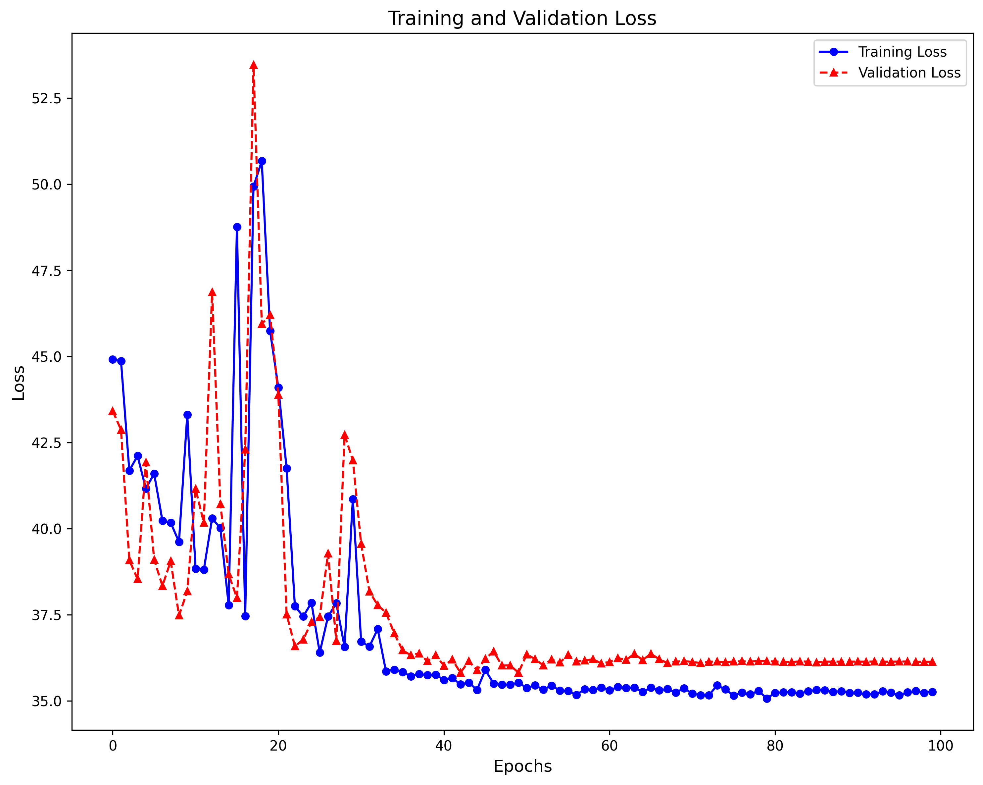
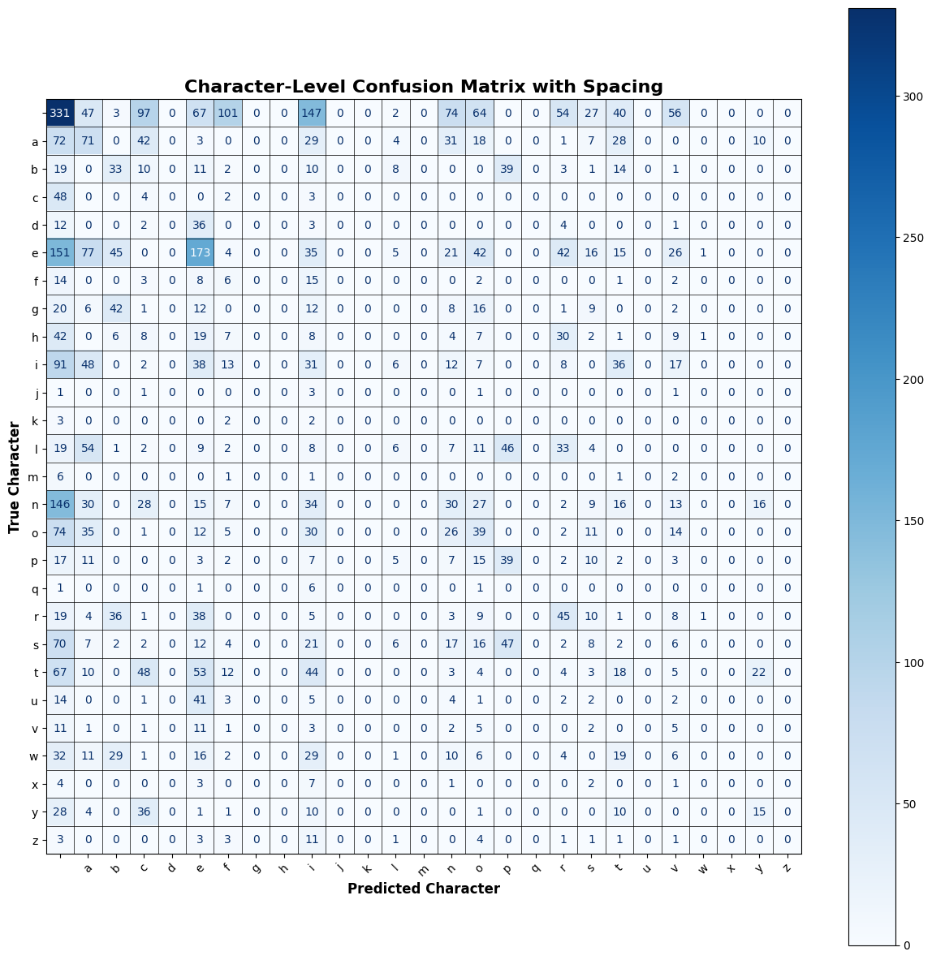
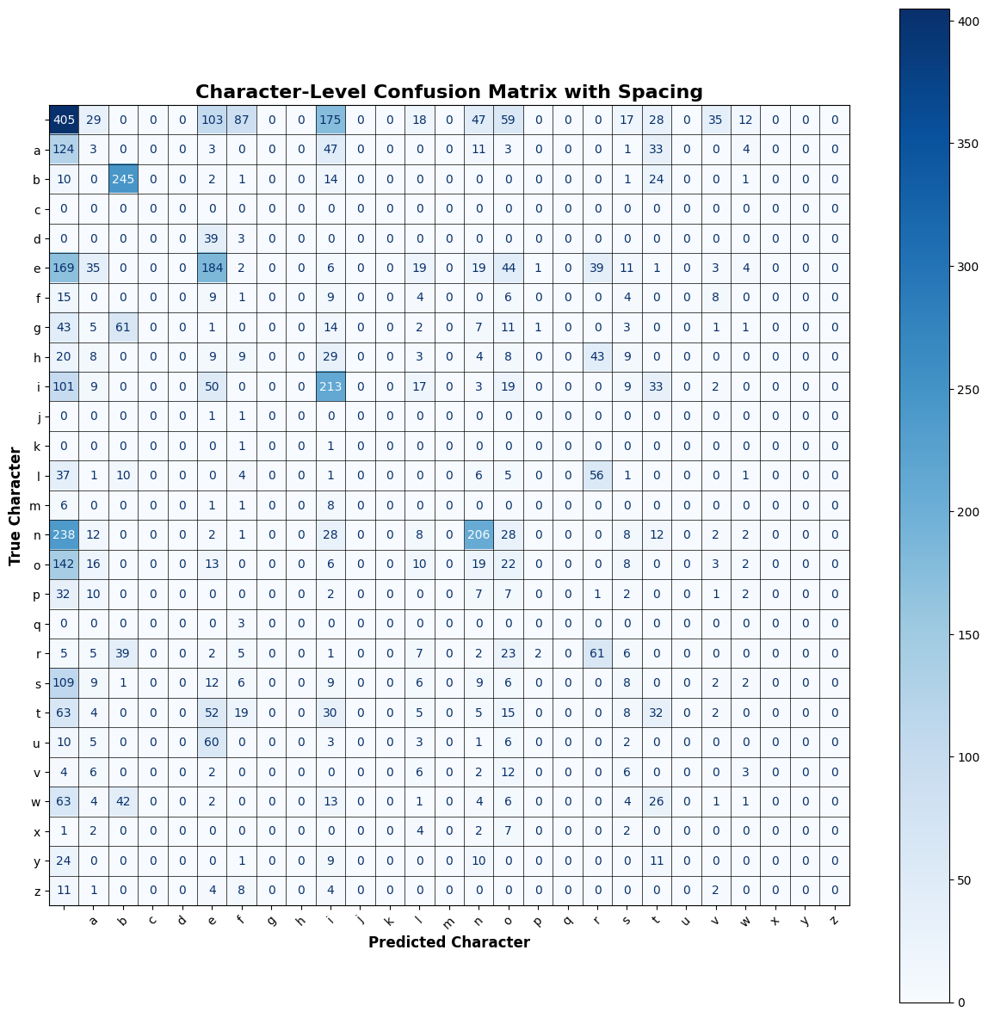
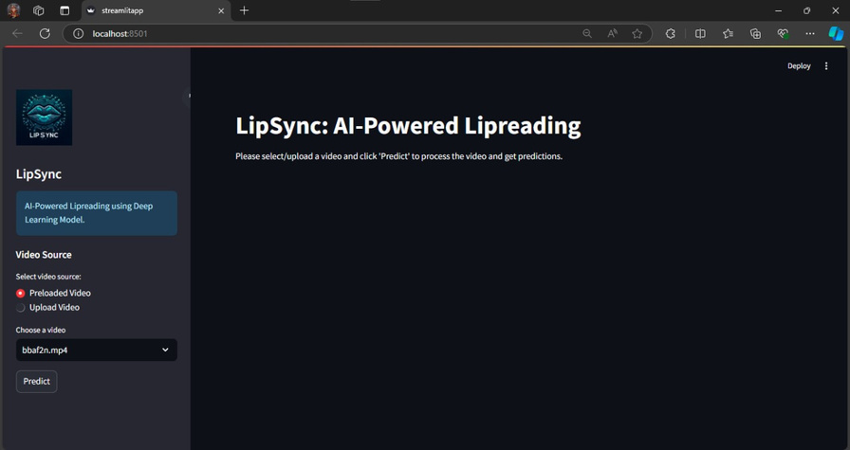
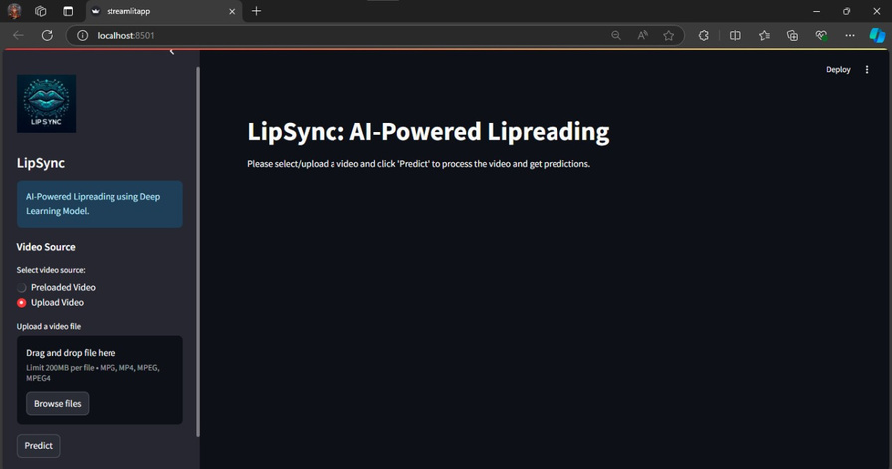
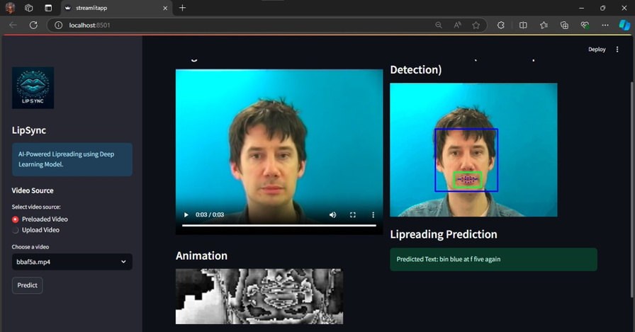
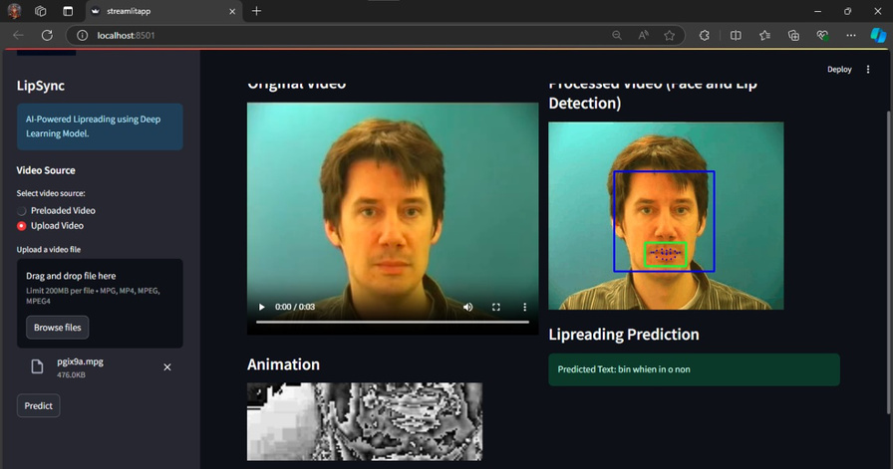
LipSync: AI-Powered Lipreading for Speech Prediction from Videos
Padshala Smit Jagdishbhai (21BCP187) & Tej Chetan Joshi (21BCP190)
Mentor: Dr. Shilpa Pandey (Assistant Professor)
Department of Computer Science & Engineering, School of Technology, Pandit Deendayal Energy university, Gandhinagar, Gujarat, India
Brief Motivation
Objective
Predict Speech from Videos
LipSync uses AI to predict spoken words from lip movements in videos, enabling communication without sound.
1
Objective 01
Create an AI model that accurately decodes speech from lip movements in videos using deep learning techniques like CNNs and LSTMs.
Accurate Speech Prediction
The goal is to create a highly accurate model that can reliably convert lip movements into speech, improving communication clarity.
Develop an AI Lipreading System
Helping the Hearing Impaired
This technology empowers individuals with hearing impairments by making it easier for them to understand and engage in conversations.
2
Objective 02
Design a user-friendly interface with Streamlit for real-time testing and evaluation of the lipreading system’s performance.
Build a Real-time Testing Interface
Helping Crime Investigations
LipSync can be applied to CCTV footage to identify what suspects are saying, even in silent videos, aiding criminal investigations.
3
Objective 03
Assess and improve the model’s accuracy using the GRID Corpus to outperform existing lipreading systems for better communication.
Accurate Speech Prediction
The goal is to create a highly accurate model that can reliably convert lip movements into speech, improving communication clarity.
Evaluate and Improve Accuracy
Methodology
Data Collection
Dataset Used: The project uses the GRID Corpus dataset, which contains video recordings of speakers lip-syncing structured phrases.
Video Details: Each video is 3 seconds long, recorded at a resolution of 720x576 pixels with a frame rate of 25 fps.
Speakers: The dataset includes multiple speakers, we focused on four speakers (250 video samples each), ensuring a balanced dataset for training.
Data Preprocessing
3DCNN+LSTM
Model Overview: This model combines 3D Convolutional Neural Networks (Conv3D) and Bidirectional LSTM layers to process spatiotemporal data, ideal for video classification or medical imaging.
Input: Shape (75, 46, 140, 3) -75 time steps, 46x140 spatial dimensions, 3 channels.Conv3D Layers: Extract spatial features with 3 layers (64, 128, 256 filters) and max pooling.
Batch Normalization: Stabilizes training.
Reshape: Keeps time steps, flattens spatial dimensions.
Bidirectional LSTM Layers: Three layers (64, 128, 256 units) capture temporal dependencies with dropout.
Dense Layers: Two 256-unit layers for high-level feature integration, followed by a softmax output.
Key Features:
3D Convolution for spatial features.
Bidirectional LSTMs for temporal patterns.
Dropout for regularization.
Frame Extraction: Videos are broken down into individual frames (75 frames per 3-second video).
Face and Mouth Detection: Haarcascade Classifiers are used to detect faces, isolating the mouth region for focus.
Lip Region Cropping & Resizing: The mouth region is cropped and resized to 46x140 pixels for consistency.
Normalization: The pixel values of each frame are normalized to stabilize training and improve model performance.
Model Architecture
The project uses two deep learning models to predict speech from lip movements:
3DCNN + LSTM Model 3D Convolutional Layers: Extract spatial features from video frames (captures lip movement details). LSTM Layers: Model the temporal dependencies between frames, learning how lip movements evolve over time.
VGG16 + LSTM Model VGG16: A pre-trained Convolutional Neural Network (CNN) used for detailed feature extraction from lip movements. LSTM Layers: Process the sequence of frames over time to predict speech accurately.
Training & Loss Function
Model Overview: This model combines VGG16 for spatial feature
extraction and Bidirectional LSTM layers for sequence learning, ideal
for tasks like action recognition or video captioning.
Input: Shape (time_steps, height, width, channels) (e.g., (75, 46, 140, 3)).
VGG16 Feature Extraction: Uses pre-trained VGG16 (without top layers) with TimeDistributed for frame-wise feature extraction.
Reshape: Flattens spatial dimensions while preserving temporal steps.
Bidirectional LSTM Layers: Three LSTM layers
(128 units) capture temporal dependencies with
dropout for regularization.
Dense Layers: 256-unit Dense layer, followed
by a softmax output layer for classification.
Key Features:
VGG16 for spatial features.
Bidirectional LSTMs for temporal patterns.
Dropout for regularization.
Training Setup: Dataset Split: 80% for training, 20% for testing. The training data was further split into 80% for training and 20% for validation.
The models were trained 4 times: 50 epochs for VGG16, 50 epochs for 3DCNN, 100 epochs for VGG16 and 100 epochs for 3DCNN
Learning Rate Scheduler: The learning rate was reduced by 0.1 every 20 epochs to improve convergence and model performance.
VGG16+LSTM
Application Development
User Interface: A Streamlit-based web application allows real-time lipreading predictions from video files.
Video Upload: Users can upload MP4 or MPG videos.
Pre-loaded Videos: Test with sample GRID dataset videos for quick trials.
Real-time Prediction: The application predicts speech and displays it as text on-screen.
Expected Results
Training vs Validation Loss
Model(#epoch)
Training vs Validation WER (Word Error Rate)
Model(#epoch)
VGG(50)
CNN(100)
VGG(100)
CNN(100)
CNN(50)
VGG(100)
Character Level Confusion Matrix with Spacing
Outcomes
Bibliography/ References
Pre-Loaded Video
User-Loaded Video
[1] Kuldeep Vayadande, Tejas Adsare, Neeraj Agrawal, Tejas Dharmik, Aishwarya Patil, Sakshi Zod; “Lipread Net: A Deep Learning Approach to Lip Reading”
[2] Brais Martinez, Pingchuan Ma, Stavros Petridis, Maja Pantic; “Lipreading Using Temporal Convolutional Networks”
[3] Youda Wei, Xiaodong Hu; “Text Recognition from Silent Lip Movement Video”
[4] Leyuan Qu, Cornelius Weber and Stefan Wermter; “LipSound2: Self-Supervised Pre-Training for Lip-to-Speech Reconstruction and Lip-Reading”
[5] Daehyun Lee, Kyungsik Myung; “Read My Lips, Login to the Virtual World”
[6] Prof. Shwetha K 𝑆, Rohith M 𝐾, Sakshi Prashant Yandagouda𝑟, Sinchan𝑎, Ameen Hafee; “Silent Interpreter: Analysis of Lip Movement and Extracting Speech Using Deep Learning”
[7] M. Assael, B. Shillingford, S. Whiteson, and N. de Freitas, ‘‘LipNet: End-to-end sentence-level lipreading’’
[8] Dr. Mamatha G, Bharath Roshan B R, Vasudha S R; “Lip Reading to Text using Artificial Intelligence”
[9] GRID Corpus Dataset

